Slide 1
Smart Home
Done by:
Ali Mohamed
Alaa El Deen

Slide 2
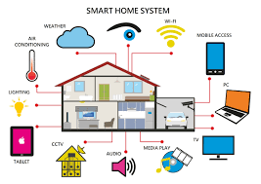
Introduction
Smart homes enable homeowners to operate appliances, thermostats, lights, and other equipment remotely using a smartphone or tablet connected to the internet.
Wireless or hardwired technologies can be used to build up smart houses . Smart home technology offers homeowners convenience as well as cost savings.

Slide 3
Components Used
Keypad
Microcontrollers
light Bulbs
LCDs
Servo Motor
DC Motor
Temperature Sensor
Potentiometer
Oscilloscope
Virtual Terminal

Slide 4
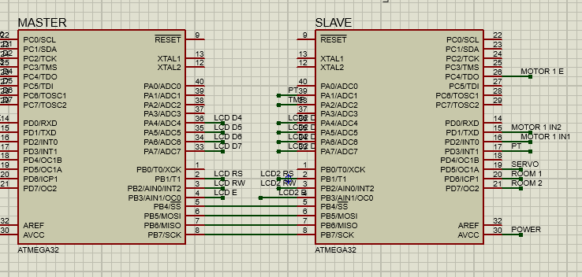
Microcontrollers Connection
SPI was used to communicate between both microcontrollers to control the hardware components
The Master controls the interaction between the user and the hardware components the master controller sends and receives data from the slave through wired connection between the two micro controllers

Slide 5
Master Microcontroller
The Master Microcontroller is used to operate the whole system and to select what is done in the house.
The components connected to the Master Microcontroller are the:
  Keypad: Used to enter password and allows interaction with the user
  LCD: Used to provide output done by the user
  Bluetooth Module: Used to interact wirelessly with the user using UART Communication

Slide 6
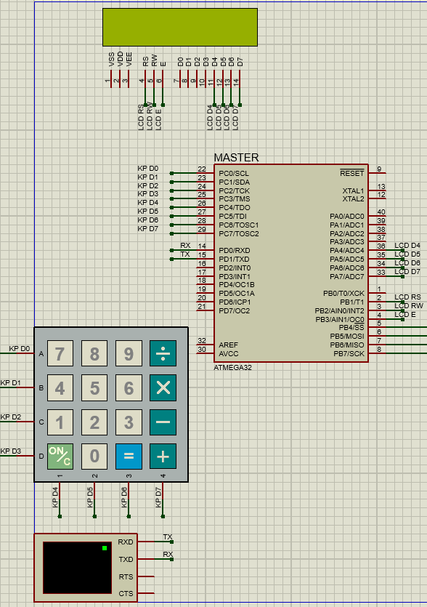
Master Microcontroller

Slide 7
Slave Microcontroller
The Slave Microcontroller is used to receive data from the Master Microcontroller and to send data to the Master Microcontroller.
The components connected to the Master Microcontroller are the:
  LCD: Used to display the input from the Master Microcontroller
  Temperature Sensor: Used to detect the temperature of the surrounding
  Potentiometer : Used to control the brightness of the Room
  2 Light bulbs : The light bulbs are used to represent the rooms
  DC Motor :Used to represent the Air Conditioner when the temperature is below 31 degrees Celsius the AC is turned off which means that the DC Motor stops operating and operates when the temperature is higher than 31 degrees Celsius.
  Servo Motor: Used by the owner of the house to open the door of the house.

Slide 8
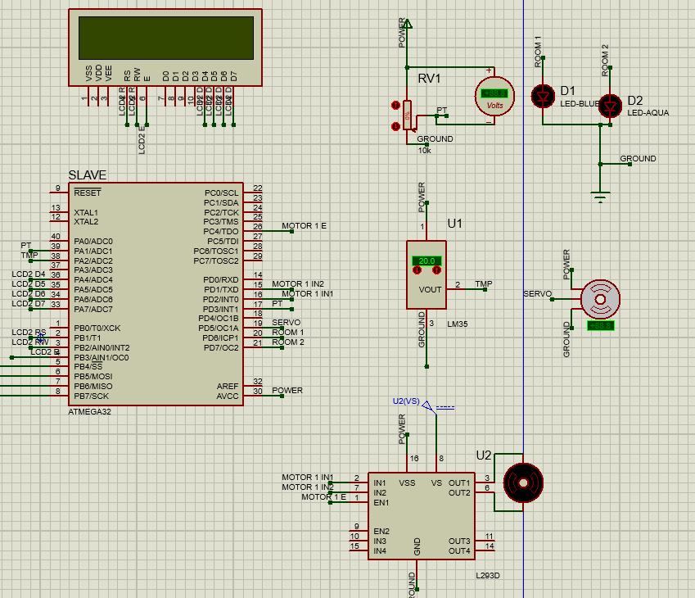
Slave Microcontroller

Slide 9
EEPROM
EEPROM was used to allow access of the Admin and the guest and to save their data.

Slide 10
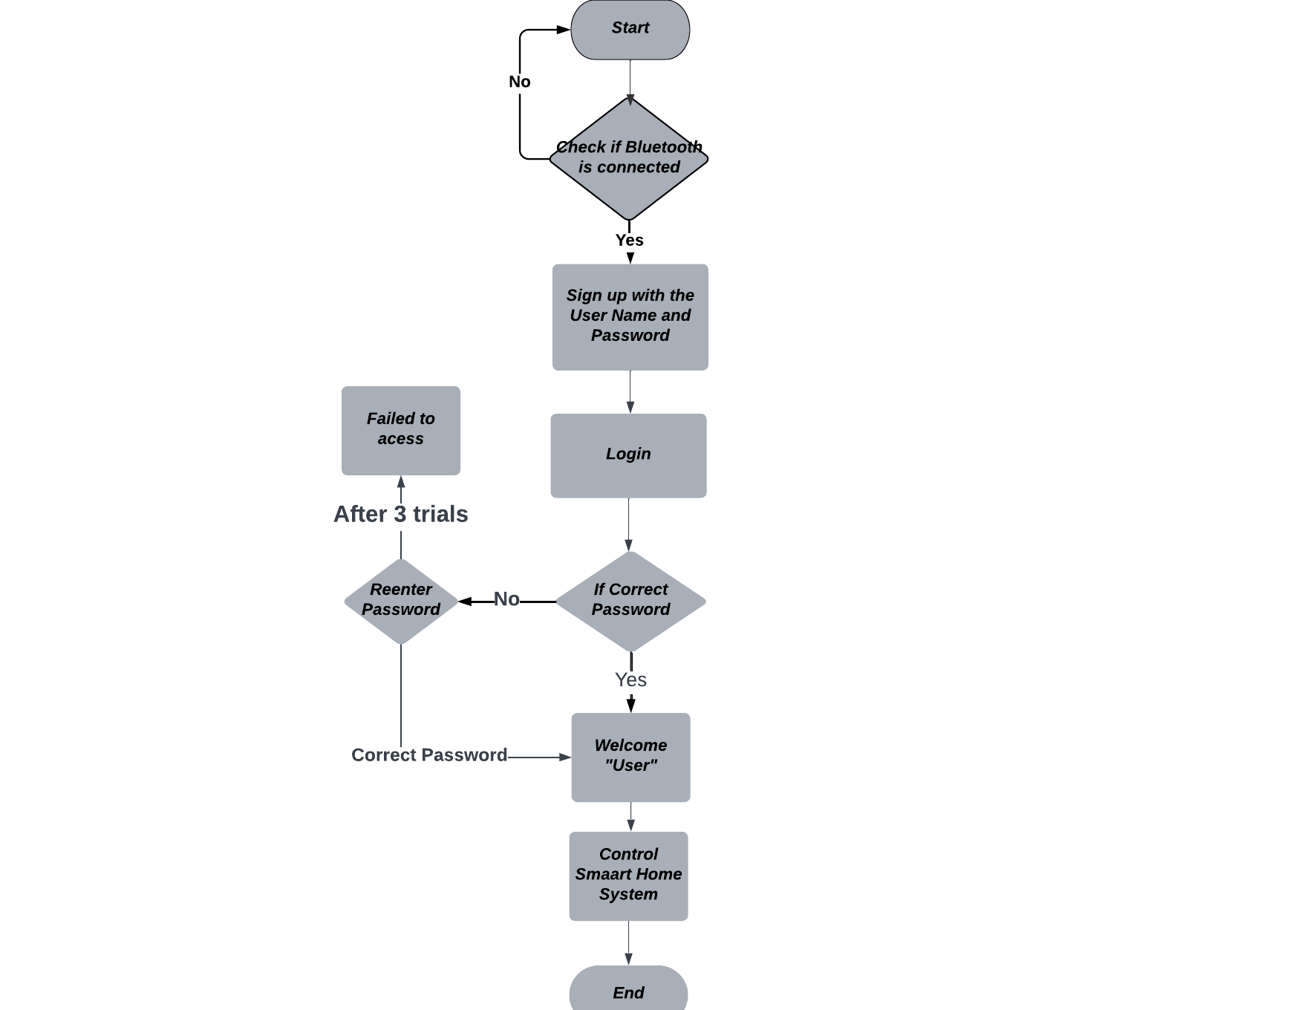
Flow Chart

